Slide 1
Drugs in Sport
Geoff Oldfield PLT 29/01/20

Slide 2
Objectives
Know about the different categories of drugs
Be able to explain the impact of performance-enhancing drugs on wellbeing and performance and why some performers might risk using them to enhance performance
Be able to describe and explain how samples are collected in and out of competition and at major events
Be able to explain how athletes, from beginner to elite, should be aware of drugs and drug testing.
Notes:
Summarize your research in three to five points.

Slide 3
What is a drug?
A substance that can be taken in a variety of ways to produce expected and welcome physical and/or psychological effects on the person taking it….
….but may also cause some effects that are both unpleasant and unwanted
These are known as “side effects”.

Slide 4
Categories of Drugs
There are two main categories:
Performance-enhancing
Recreational

Slide 5
Background
1st reported use of performance enhancing drugs?
1952 USSR Testosterone by injection to improve the performance of weightlifters
International Olympic Committee enforced a full scale testing programme at the 1972 Olympic Games in Munich
Anabolic steroids not banned until 1975
In February 1999, the IOC wanted agreement on two points:
A single international doping agency
A blanket two-year ban for competitors found guilty of drug taking.

Slide 6
Banned Performance Enhancing Substances
Source: World Anti-Doping Agency 2015 Prohibited List
Which “groups” of Banned Performance Enhancing Substances are these drugs from?
How do they enhance athletic performance?
What are the health effects?

Slide 7
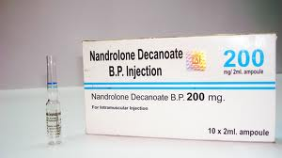
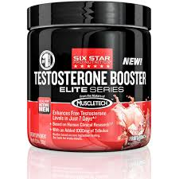
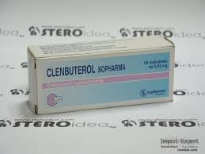
1
Notes:
This is the question that your experiment answers

Slide 8
1 Anabolic Agents (Steroids) *Exogenous Anabolic Androgenic Steroids *Endogenous Anabolic Androgenic Steroids *Other Anabolic Agents
Drugs that mimic the male sex hormone testosterone and promote
bone and muscle growth
Notes:
This is the question that your experiment answers

Slide 9
Enhances athletic performance in the following ways
endurance increase
fat loss
muscle recovery increase
muscular size and strength increase in combination with exercise

Slide 10
Health Effects
abnormal menstrual cycles (females), acne, aggressiveness, asthenia, baldness, brain tissue damage, breast enlargement (males), clitoris enlargement (females), depression
dizzy spells, fever, hair growth on the face and body (females)
HIV and other disease contraction due to contaminated needles used for injection of steroid
hypertension, impotence (males), kidney tumours, liver dysfunction, mania,
masculinization (females), muscle strains or ruptures, myalgia, nausea, periorbital pain, prostate gland enlargement (males), psychiatric dysfunction,
sexual appetite increase, sperm production reduction (males), stunted growth (in adolescents)
Tearing of tendons, testicular shrinkage or atrophy (males), voice deepening (females)

Slide 11
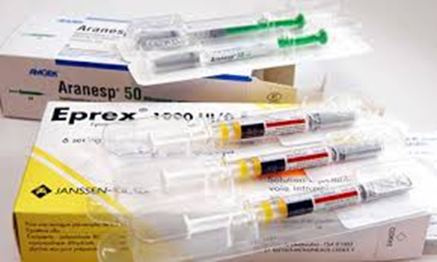
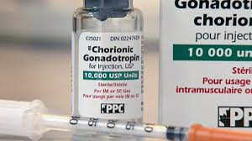
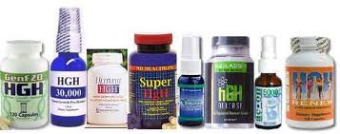
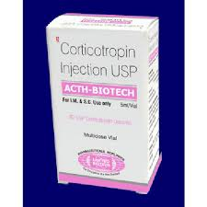
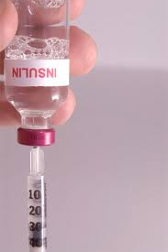
2
Notes:
Write hypothesis before you begin the experiment. This should be your best educated guess based on your research.

Slide 12
2 HORMONES and related substances *EPO *hGH (somatotrophin) *Gonadotrophins *Insulins *Corticotrophins
Drugs that cause other hormones to be produced
Notes:
Write hypothesis before you begin the experiment. This should be your best educated guess based on your research.

Slide 13
Enhances athletic performance in the following ways
EPO - endurance capabilities enhancement during exercise, muscle recovery increase
hGH - body fat percentage decrease, growth stimulation, muscle definition enhancement, muscle size and strength increase, muscle tissue repair, protein synthesis increase
Gonadotrophins (e.g. LH, hCG) - masking agent (for anabolic steroids), testicular damage (due to anabolic steroid use) counteraction, testosterone and epistestosterone production stimulation
Insulins - muscle definition when used in conjunction with other substances, muscle growth when used in conjunction with other substances, protein breakdown reduction
Corticotrophins (ACTH) - increases adrenal corticosteroid levels, antiinflammatory action aids recovery from injury

Slide 14
Health Effects
EPO - Death, deep vein thrombosis, heart attack, hyperviscosity of the blood, myocardial infarction, pulmonary embolism, stroke, thrombosis
hGH – abnormal body changes, acromegaly, antibody formation, arthritis, brain swelling, cardiomyopathy, congestive heart failure , coronary artery disease, Cruetzfeldt-Jakob disease development when drug is produced from cadaveric specimens, diabetes mellitus, diabetic (hypoglycemic) coma, facial nerve paralysis, forehead and jaw shape change, hand enlargement, heart enlargement, hypercholesterolemia, hypoglycemia, hypothyroidism, impotence, menstrual irregularities, metabolic dysfunction, myopathies, osteoporosis
Gonadotrophins (e.g. LH, hCG) – increased risk of gynaecomastia, similar effects as anabolic steroids
Insulins - brain damage, breath shortness, coma, death, drowsiness, hypoglycaemia, nausea, shaking, weakness
Corticotrophins (ACTH) - psychological effects such as irritability, softening of connective tissue, stomach irritation and ulcers, weakening of an injured area in muscles, bones, tendons or ligaments, osteoporosis and cataracts

Slide 15
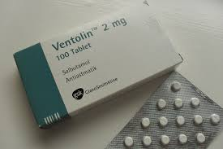
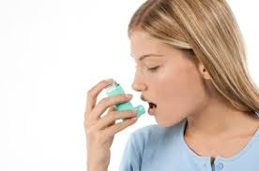
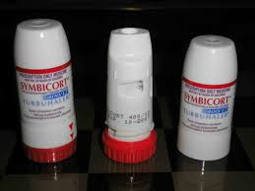
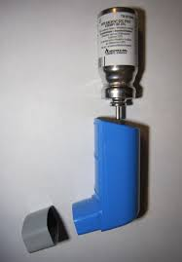
3
Notes:
Write hypothesis before you begin the experiment. This should be your best educated guess based on your research.

Slide 16
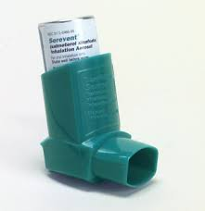
3 All beta-2 agonists including their D- and L- isomers, eg
Theraputic Use Exemption
Notes:
Write hypothesis before you begin the experiment. This should be your best educated guess based on your research.

Slide 17
Enhances athletic performance in the following ways
aerobic exercise improvement
fat reduction
muscle growth

Slide 18
Health Effects
anxiety, arrhythmias,
dizziness, headache,
insomnia, mood disorders
muscle cramps, nausea
palpitations, sweating
tachycardia
tremor (usually of the hands)

Slide 19
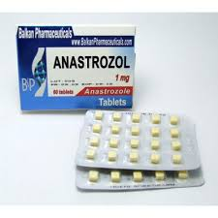
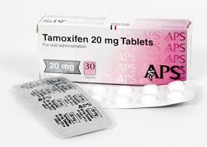
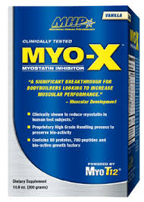
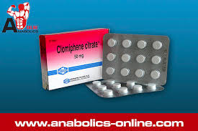
4
Notes:
This is the question that your experiment answers

Slide 20
4 HORMONE ANTAGONISTS & MODULATORS *Aromatase inhibitors eg Anastrozol *Selective estrogen receptor modulators (SERMs) eg Tamoxifen *Other anti-estrogenic substances eg Clomiphene *Agents modifying myostatin function(s) eg Myo-x
These act to either decrease the amount of oestrogen in the body or block the oestrogen receptors.
Notes:
This is the question that your experiment answers

Slide 21
Enhances athletic performance in the following ways
anabolic effects
strength increase
reduction of anabolic steroid use side effects (i.e. breast tissue growth)

Slide 22
Health Effects
abdominal discomfort
cancer
hot flushes
libido reduction
verbal slurring

Slide 23
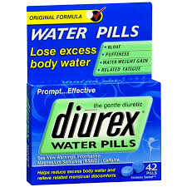
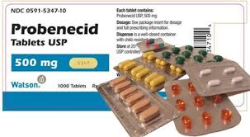
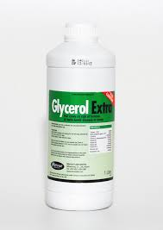
5
Notes:
This is the question that your experiment answers

Slide 24
5 Diuretics and Other masking agents eg, Diurex, Probenecid, Glycerol
Drugs that elevate the rate of urine production or hide the presence of other drugs
Notes:
This is the question that your experiment answers

Slide 25
Enhances athletic performance in the following ways
prevent detection of banned substances
produce urine excretion to reduce concentration of banned substances
weight loss

Slide 26
Health Effects
blood pressure drop, cramps
death, dehydration, dizziness
electrolyte imbalance
headaches, heart failure
kidney failure
muscle cramps, nausea
potassium depletion, volume depletion

Slide 27
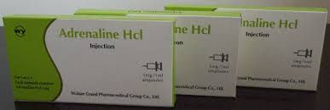
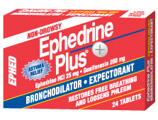
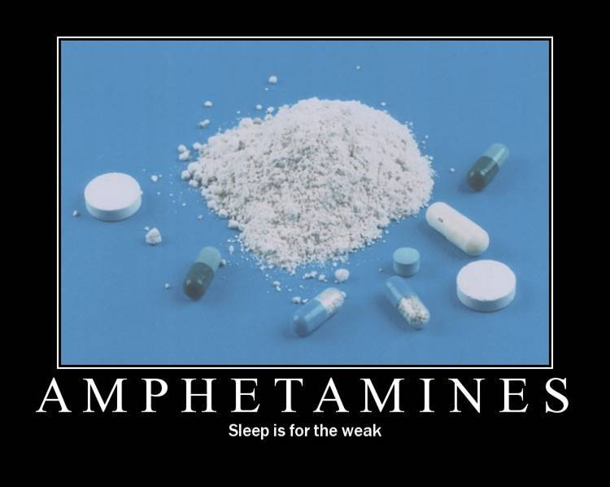
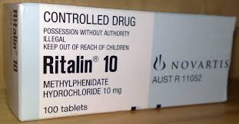
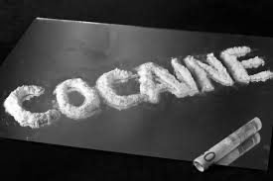
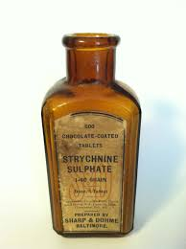
6
Notes:
This is the question that your experiment answers

Slide 28
6 Stimulants eg Adrenaline, Ritalin Ephedrine, Amphetamine, Cocaine, Strychnine, etc
These have an effect on the central nervous system, such as increased mental and/or physical alertness
Notes:
This is the question that your experiment answers

Slide 29
Enhances athletic performance in the following ways
aggressiveness increase
alertness increase
competitiveness increase
responsiveness increase
tiredness reduction
weight loss

Slide 30
Health Effects
addiction/withdrawal, aggressiveness, alertness, anxiety,
blood pressure increase, cardiac arrhythmia,
cerebral haemorrhage, coma, convulsions,
death, dehydration, hand tremors, heart attack,
heart rate increase, heat stroke,
inhibited judgment and decision making, Insomnia,
stroke, sweating, tremor, weight loss

Slide 31
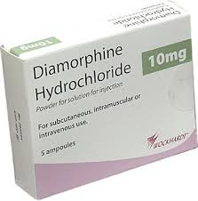
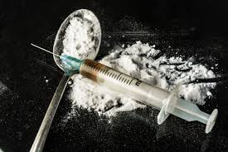
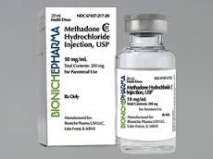
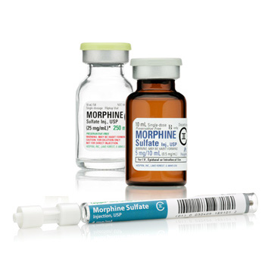
7
Statement of the problem
Notes:
This is the question that your experiment answers

Slide 32
7 Narcotics eg diamorphine (heroin), methadone, morphine, etc
Drugs that can be used to reduce pain
Notes:
This is the question that your experiment answers

Slide 33
Enhances athletic performance in the following ways
invincibility feeling
pain killer
pain threshold increase
sensation of euphoria

Slide 34
Health Effects
addiction/withdrawal, balance and coordination loss
cardiovascular collapse, concentration ability decrease
death, injury risk
nausea
respiratory depression
sleepiness
vomiting

Slide 35
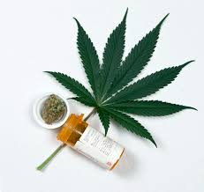
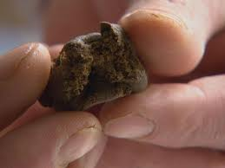
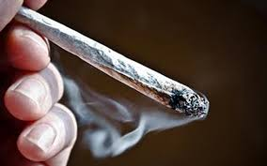
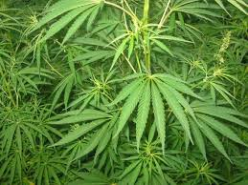
8
Notes:
Write hypothesis before you begin the experiment. This should be your best educated guess based on your research.

Slide 36
8 CANNABINOIDS eg hasish, marijuana
These drugs can be used as a sedative and can have a calming effect
Notes:
Write hypothesis before you begin the experiment. This should be your best educated guess based on your research.

Slide 37
Enhances athletic performance in the following ways
euphoric sensation
sedative

Slide 38
Health Effects
addiction/withdrawal, anxiety, apathy, appetite increase,
balance and coordination impairment, bronchitis,
cancer in the lung, throat, mouth, and tongue
concentration loss, Drowsiness, hallucinations,
heart rate increase, dry mouth, learning ability impairment,
memory impairment, mood swings, motivation loss
motor skill impairment, panic attacks
paranoid thinking, reflex loss, weight gain

Slide 39
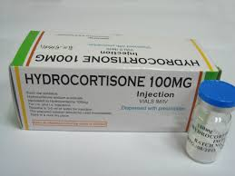
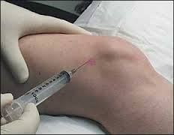
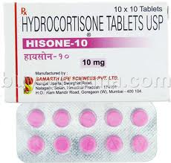
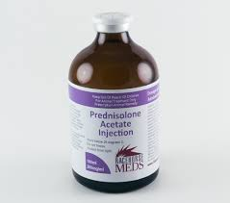
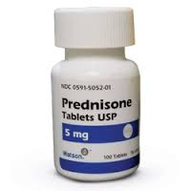
9
Notes:
Write hypothesis before you begin the experiment. This should be your best educated guess based on your research.

Slide 40
9 GLUCOCORTICOSTEROIDS eg Hydrocortisone, Prednisolone and Prednisone.
These are anti-inflammatory steroid hormones produced in the adrenal glands.
Notes:
Write hypothesis before you begin the experiment. This should be your best educated guess based on your research.

Slide 41
Enhances athletic performance in the following ways
anti-inflammatory agent

Slide 42
Health Effects
fluid retention
hyperglycemia
mood alteration
musculoskeletal problems
systemic infections

Slide 43
10
Notes:
Write hypothesis before you begin the experiment. This should be your best educated guess based on your research.

Slide 44
10 Alcohol
Notes:
Write hypothesis before you begin the experiment. This should be your best educated guess based on your research.

Slide 45
Enhances athletic performance in the following ways
anti-anxiety effect
maximize effects of other drugs taken at the same time
sedative

Slide 46
Health Effects
addiction/withdrawal, cirrhosis of the liver
death, depression, double vision
Incontinence, judgment impairment
memory and comprehension loss
reflex and muscular coordination impairment
sleepiness, speech slurring,
suicide, vomiting

Slide 47
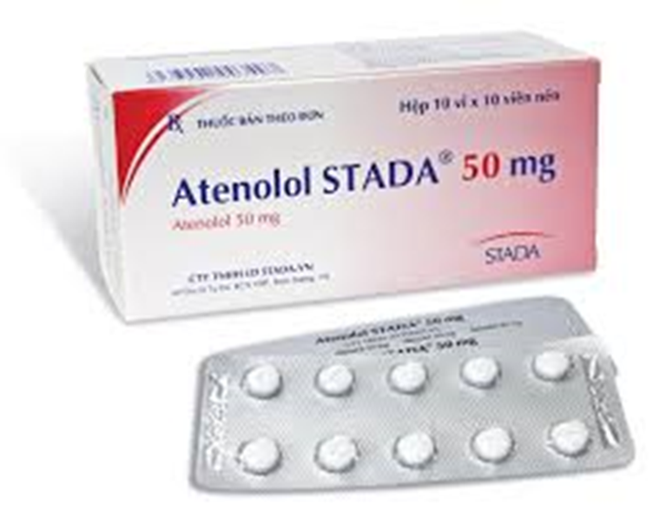
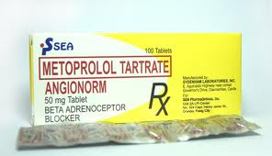
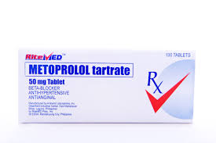
11
Notes:
Write hypothesis before you begin the experiment. This should be your best educated guess based on your research.

Slide 48
11 Beta Blockers
These are used to control the heart rate and have a calming and relaxing effect
Notes:
Write hypothesis before you begin the experiment. This should be your best educated guess based on your research.

Slide 49
Enhances athletic performance in the following ways
muscle tremor reduction in precision sports
sedative

Slide 50
Health Effects
blood pressure lowering
heart rate decrease
performance capacity decrease in endurance sports
sleep disturbance
tiredness

Slide 51
Banned Methods
enhancement of oxygen transfer (i.e. blood doping and artificially enhancing the uptake, transport or delivery of oxygen)
chemical and physical manipulation
gene doping
Notes:
Summarize your research in three to five points.

Slide 52
Blood Doping
PROs
endurance performance improvement
ability to perform better at higher altitudes
CONs
Allergic reactions if wrong blood type is used, blood poisoning, cardiac output decrease,
contraction of infectious diseases such as viral hepatitis, malaria, cytomegalovirus, or HIV
Death, heart failure, hypertension, immune system overload, Infection, intravascular clotting, iron overload,
kidney damage, plate, et count reduction, sexual dysfunction, Thrombosis, transient fever
Notes:
Summarize your research in three to five points.

Slide 53
Chemical and Physical manipulation
Chemical and physical manipulation of samples can include tampering with samples, substitution and/or alteration of urine, catheterisation, and intravenous infusion. Such manipulation can allow athletes to benefit from the use of performance enhancing drugs without testing positive for prohibited substances.
Intravenous infusion is also prohibited unless there is an acute medical situation (i.e. acute blood loss) in which the use of this method is necessary.
Cons
infection
over hydration
Notes:
Summarize your research in three to five points.

Slide 54
Gene Doping
Gene doping, when used in sports, can provide a variety of performance enhancing effects depending on the function of the gene.
Effects are unknown due to expertimental phase of gene doping technologies
Notes:
Summarize your research in three to five points.

Slide 55
Changes to the World Anti-Doping code 2015 1
Article 2: Anti-Doping Rule Violations Some significant changes are made to the way in which anti-doping rule violations will be prosecuted.
Whereabouts violations will now be administered if three missed tests (and/or filing failures, such as supplying incorrect whereabouts information) take place within the same 12 month period (replacing 18 months, which is the current period). (Article 2.4)
Involvement in an anti-doping rule violation committed by another person – such as helping to cover up that violation – will be sanctioned with a ban of up to four years. Helping someone commit a doping violation, or avoid detection, will be sanctioned in the same way as that violation. (Article 2.9)
Associating with a banned person such as a coach - or dealing with a person such as a doctor who has been found guilty of a criminal or disciplinary offence equivalent to a doping violation (such as providing banned substances) - will be sanctioned with a ban of up to two years. Athletes will be warned that they are associating with such a person before any action can be taken, and there are safeguards for athletes who have no choice but to work with such people. (Article 2.10)
Notes:
Summarize your research in three to five points.

Slide 56
Changes to the World Anti-Doping code 2015 2
Article 5: Testing and Investigations The Code provisions concerning Testing, Investigations and Analysis have been significantly improved to place the focus on intelligent, collaborative activity.
The International Standard for Testing – the Code Standard that sets the rules and procedures for the testing process – has been renamed that ‘International Standard for Testing and Investigations’, reflecting the new requirements that all Anti-Doping Organisations use intelligence and information to investigate the full range of anti-doping rule violations in the Code.
Every Anti-Doping Organisation must adopt a ‘risk-based’ approach to testing, and develop a ‘Test Distribution Plan’ (which is effectively a ‘business plan’ for testing athletes). This in turn is used to determine the amount, frequency and location of testing. Every Anti-Doping Organisation must share this plan with WADA. (Article 5.8.1)
Every Anti-Doping Organisation must have the resources to obtain, assess and handle anti-doping intelligence and information from a variety of sources, including law enforcement, to assist in the development of their Test Distribution Plans. They must also be able to use this intelligence to handle investigations into suspected doping. They must be able to utilise modern anti-doping techniques, such as the blood passport. (Article 5.8.3)
Anti-Doping Organisations will be able to use their resources efficiently by developing ‘Testing menus’ that focus on specific substances, rather than the full range of substances that Laboratories currently look for when analysing Athlete Samples. (Article 6.4)
Notes:
Summarize your research in three to five points.

Slide 57
Changes to the World Anti-Doping code 2015 3
Article 10: Sanctions The Code makes significant changes to the way in which anti-doping rule violations are sanctioned.
Cheating that involves serious doping substances (such as steroids, growth hormone and EPO) and calculated doping methods (such as blood doping or transfusions) will be sanctioned with a four-year ban. Four-year bans have always been available for these offences (and UKAD has to date secured six four-year bans against serious dopers). (Article 10.2.1)
The new Code recognises that there can be no advantage gained by failing to cooperate with the testing process – refusing to take a test, evading testing or trying to thwart the testing process will all be sanctioned with bans of up to four years.
The new Code incentivises early cooperation and information sharing by persons who are accused of committing doping violations. Admitting a violation can be rewarded with a reduced ban, with WADA having the final say on any reduction. Anti-Doping Organisations can agree reduced bans in return for the provision of ‘substantial assistance’, that is, information that leads to other doping violations being uncovered. In exceptional cases, WADA will have the power to agree to eliminate a ban in its entirety and offer complete confidentiality in return for substantial assistance. (Article 10.6)
‘Limitation periods’, that is, the timeframe within which an Anti-Doping Organisation can charge a person with committing a doping violation, have been increased from eight years to ten years. (Article 17)
Notes:
Summarize your research in three to five points.

Slide 58
Changes to the World Anti-Doping code 2015 4
Article 20: Responsibilities of Signatories The Code imposes a number of new responsibilities on Signatories.
International Federations must ensure that their member organisations share anti-doping related information with their National Anti-Doping Organisations. This is in keeping with the collaborative theme of the Code. (Article 20.3)
International Federations and National Anti-Doping Organisations must investigate all violations committed by athlete support personnel if those violations involve minors or multiple athletes.
International Federations and National Anti-Doping Organisations must cooperate fully with any anti-doping investigations initiated by WADA.
National Anti-Doping Organisations must be operationally independent. (Article 20.5)
Notes:
Summarize your research in three to five points.

Slide 59
Notes:
Summarize your research in three to five points.

Slide 60
Notes:
Write hypothesis before you begin the experiment. This should be your best educated guess based on your research.

Slide 61
Performance-enhancing Drugs: Summary
Include:
1 Anabolic steroids 8 Cannabinoids
2 Hormones and related substances 9 Glucocorticosteroids
3 Beta-2 Agonists 10 Alcohol
4 Hormone Antagonists and Modulators 11 Beta Blockers
5 Diuretics and Masking agents
6 Stimulants
7 Narcotics

Slide 62
Why risk taking performance enhancing drugs?
Improve their performance - compete at a higher level
Fame, rewards and success
Recover from injury quicker
Lose weight

Slide 63
Which sports are high risk?
Think of three different sports in which the development of muscular strength is very important
Name 3 sports in which the performers may be tempted to use diuretics to lose weight quickly
Think of an example of an event where blood doping could be used to improve performance

Slide 64
Testing Procedure
Step 1
Identify, notify and chaperone
Step 2
Provide a sample
Step 3
Divide, seal and test the sample
Step 4
Record and certify the sample
Notes:
List all of the steps used in completing your experiment.
Remember to number your steps.
Include photos of your experiment.

Slide 65
Beginner to Elite Athlete
100%me
Get Prepared
Know and understand:
what strict liability is
the importance of checking medications
the risk of using nutritional supplements
what happens in a drug test
where to look for support and advice.

Slide 66
Why Clean Sport Matters
UK Anti-Doping is the organisation responsible for making sure that all athletes who take part in sport are clean.
This means we help to educate athletes so they understand what substances they can and can’t take. We also carry out testing to help clean athletes prove that their achievements are real – while catching and prosecuting those who choose to improve their performance by unfair means.
Sportsmen and women want to know that other athletes are competing fairly, that it is a competition of talent and that all performances are natural. This is the spirit of sport.
UK Anti-Doping has a programme for athletes called 100% me which provides information and education to support you, as an athlete, to compete fairly. Keep yourself up-to-date with anti-doping information by visiting the Athlete Zone regularly.
UK Anti-Doping also works with sports governing bodies to help them support their athletes. Do you know what the National Governing Body is for the sport you compete in? You can find out more on theSport England website.

Slide 67
Clean Sporting Success
It’s important that you understand what it means to compete clean and have an awareness of anti-doping. Here are some top tips to help you in anti-doping:
Get prepared: Find out about what an athlete is required to do, how they can keep themselves clean and learn from the mistakes athletes may have made in the past. Start to learn about anti-doping now so that when you reach the top you are not putting yourself in a position where you may have broken the rules. Making silly mistakes still causes athletes to be banned from sport.
Safety First: You would always check your sporting equipment to make sure it is safe to use. The same applies to the things you take such as medications. Checking a medication is safe to take, such as a cold remedy from the chemist or antibiotics from a doctor, is a core skill that athletes need to learn how to do.

Slide 68
Categories of Drugs
There is a long list of banned substances which athletes cannot take. This is known as the Prohibited List. It contains a range of substances you may have heard of including steroids, stimulants and even methods such as blood doping.
Some medicines contain these banned substances so athletes need to get into the habit of checking any medications BEFORE they take them.
The questions you should always ask yourself are: are these safe to take? And, who can help me decide?
Always:
TELL people you are involved in sport and cannot take a banned substance
CHECK medications are safe to take before you use them
ASK someone for help if you are unsure
There are no Short cuts
There are no short cuts to sporting success. It takes hard work, dedication and personal drive to become the best you can be.

Slide 69
Type your answer / solution here
Hypothesis
Notes:
Write hypothesis before you begin the experiment. This should be your best educated guess based on your research.

Slide 70
Materials
Materials (detailed list) | Quantity (be specific)
Item | Amount
Item | Amount
Item | Amount
Item | Amount
Item | Amount
Item | Amount
Item | Amount

Slide 71
Data/Observations
Include Observation based on the data from your experiments

Slide 72
Variables
Controlled variables
Independent variable
Dependent variable
These are kept the same throughout your experiments
The one variable you purposely change and test
The measure of change observed because of independent variable
Decide how you will measure the change

