Slide 1
Ready to Write?
Facilitator – Lesley Doughty

Slide 2
Course outcomes
explain the importance of gross motor skills in the writing process
identify the key gross motor skills that support the development of writing
plan and deliver fun activities that support development of the key gross motor skills

Slide 3
Gross Motor Skills and Handwriting
The gross motor skills involved in handwriting are postural control, motor planning and hand-eye co-ordination.

Slide 4
Postural Control
Efficient control of the larger muscle groups in the neck, shoulder and trunk is necessary to maintain stability in order for the fingers and hands to move to complete the handwriting task.

Slide 5
Development of postural control
As children develop, control and stability develops in the following order:
Trunk
Shoulder
Elbow
Wrist
Hand
Fingers
With normal development, fine motor skills are developed from gross motor skills.

Slide 6
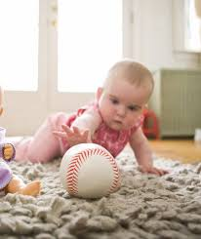
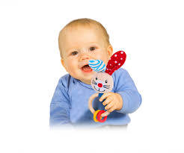
Swat
Reach
Grasp
Children need to develop the proximal muscles (closer to the centre of the body) of the trunk and shoulder girdle in order to use the distal muscles (further from the centre of the body) in the fingers and hands.
Manipulate
Notes:
These proximal muscles develop in children with gross motor movements such as reaching, tummy time, rolling, all fours position, crawling, standing and walking.

Slide 7
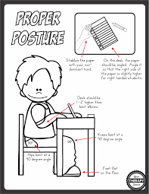

Slide 8
Research
‘Muscles that work primarily as stabilizers, display less variability than muscles that work dynamically’ (Pepper & Carson, 1999).
‘When the proximal muscles stabilize correctly, the decreased variability in the distal muscles has been shown to be associated with a faster handwriting speed’ (Naider-Steinhart & Katz-Leurer, 2007).

Slide 9
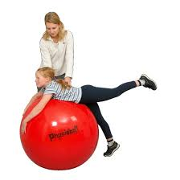

Slide 10
Motor Planning
Motor planning is the ability to conceive, plan, and carry out a skilled, non-habitual motor act in the correct sequence from beginning to end. Incoming sensory stimuli must be correctly integrated in order to form the basis for appropriate, coordinated motor responses.

Slide 11
Motor Planning
With handwriting tasks, motor planning requires muscle groups to work together with the proper force, timing and actions to produce an acceptable outcome (ie legible handwriting). For example, in order to write with a pencil, the brain has to plan and carry out the skill in the correct sequence. Starting with the pectoral muscles, the trapezius and the rhomboid muscles coactivating with the proper force and timing to stabilize the shoulder in order for the fingers and hand to move the pencil along the paper efficiently.

Slide 13
Research
‘Children with decreased motor planning skills exhibit poor legibility of handwriting compared to their peers’ (Tseng & Murray, 1994).

Slide 14
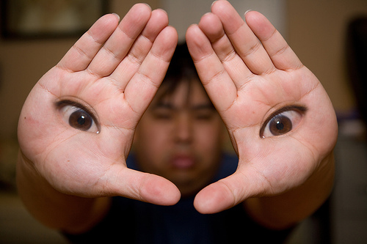
Hand-eye co-ordination
Hand-eye coordination skills require the vision system to coordinate the information received through the eyes to control, guide, and direct the hands in the accomplishment of a given task. Again, this direction requires the gross motor movements of reaching and grading the control of the arm.

Slide 15
Research
‘When the visual system does not send the correct message to the trunk, shoulders and hands on where to move, you are not able to produce coordinated motor actions. Decreased eye-hand coordination abilities have been shown to be predictive of decreased quality of handwriting’ (Kaiser, 2009)

Slide 16
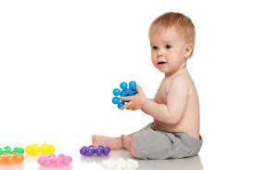
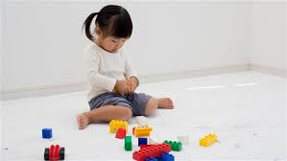
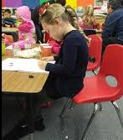
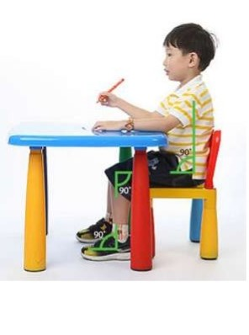
Spotting problems - seated balance and core strength

Slide 17
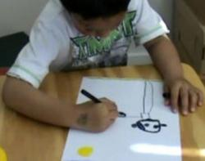
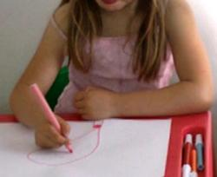
Spotting problems – shoulder strength, stability and mobility

Slide 18
MODIFICATIONS TO HELP WITH GROSS MOTOR SKILLS AND HANDWRITING
First and foremost, children should be properly positioned for handwriting:
a.) the feet should have a stable base of support
b.) hips, knees and ankles should be bent at 90 degrees
c.) desk should be 1-2” higher than bent elbows
For proximal muscle fatigue while writing, try changing positions. Perhaps lying on the floor to complete the writing assignment or providing a slant board may help. Try breaking up writing assignments into smaller chunks to prevent proximal muscle fatigue.
Take frequent breaks to stretch the muscles in the shoulder, neck and back.
The best suggestion is to sometimes put down the pencils, take a break from routine handwriting practice and get children moving!

Slide 19
Contact Details
Lesley Doughty
PE and Sport Training and Consultancy
E-mail: lesley.doughty67@gmail.com
Mobile: 07825589202

